Slide 1

JERMAIN BARRY LUTSAI
Aspiring SOC Analyst | Cybersecurity Home Lab Engineer

Slide 2
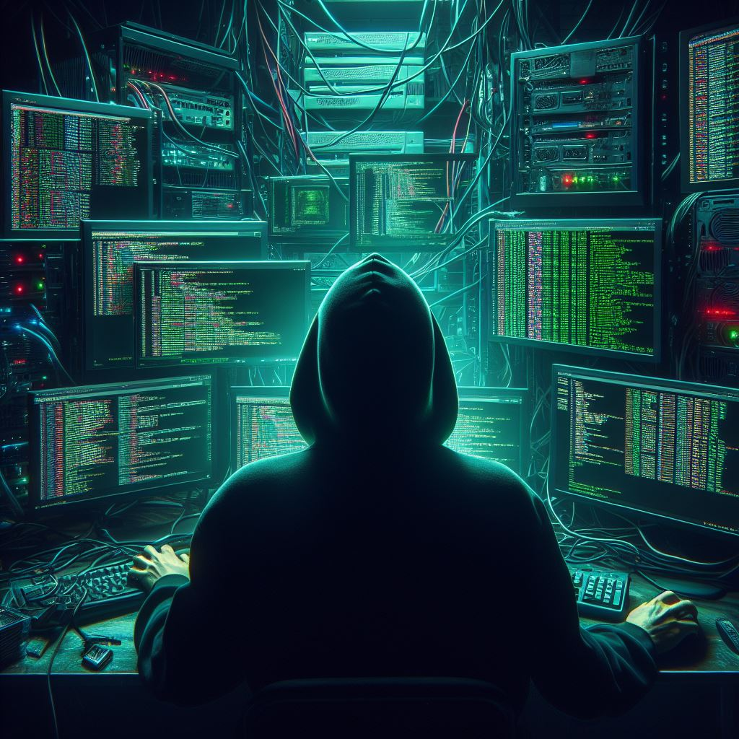
ABOUT ME
I'm a self-taught cybersecurity professional with a passion for building solutions.
I’ve trained with SIEM tools like Splunk & Wazuh, created my own SOC home lab.

Slide 3
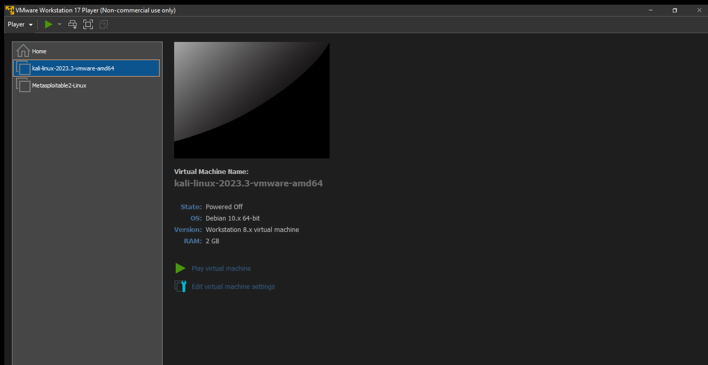
HOME LAB SETUP
The setup includes Kali Linux (attacker), metasploitable (victim).
Wazuh is used to monitor logs, detect threats and incident response.

Slide 4
SIMULATION PROCESS
Threat
Kali Linux
Detection
Wazuh
Dashboard
Visualization

Slide 5
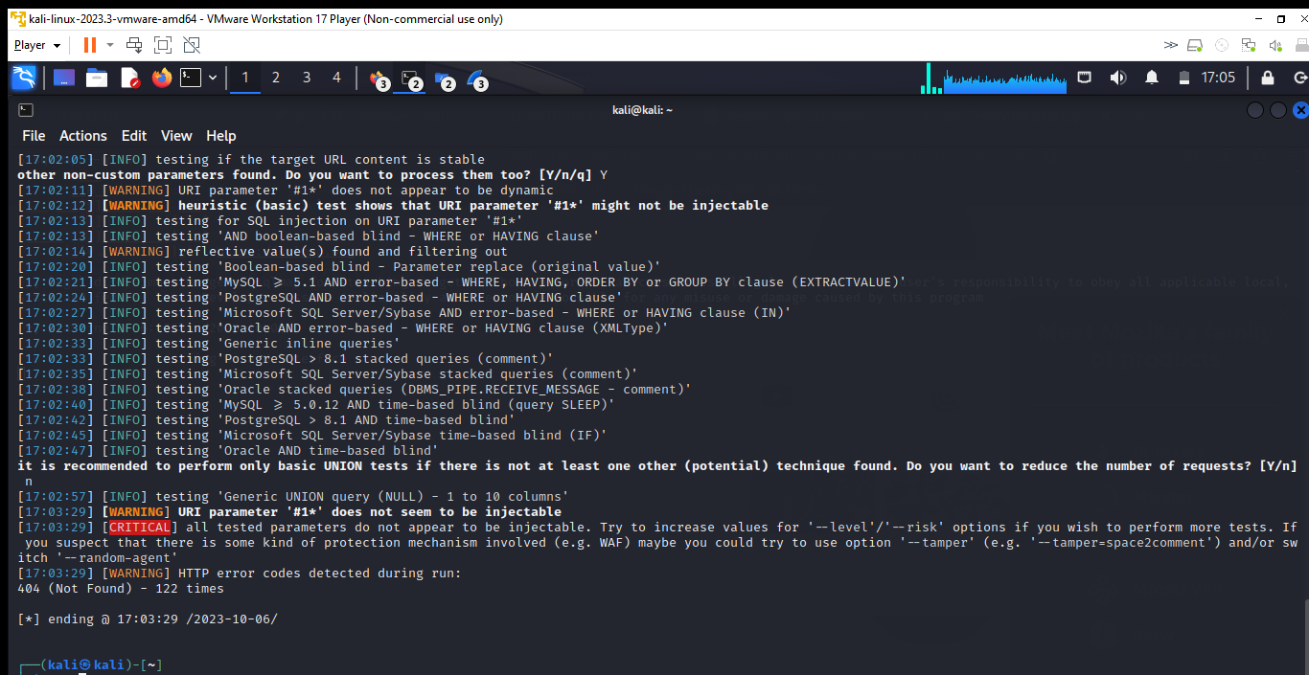
THREAT DETECTION
Beyond my dashboard, I’ve worked on projects that helped me simulate threats, analyze patterns, and understand attacker behavior. These experiences built the foundation for what I showcased in my lab.

Slide 6
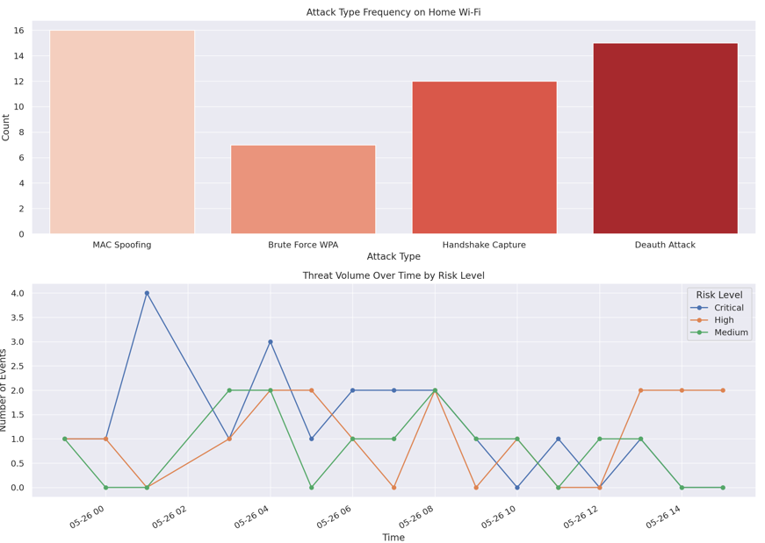
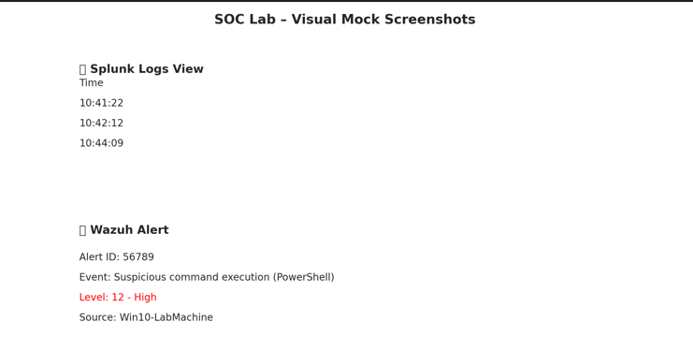
PROJECT SUMMARY
Splunk & Wazuh (System Monitoring)
Dashboard

Slide 7
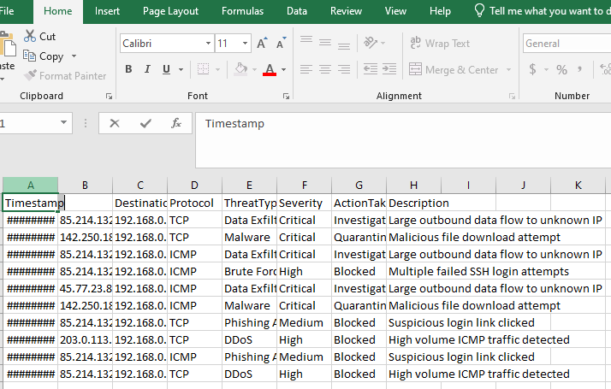
PROJECT SAMPLES

Slide 8
Why Me?
Didn’t wait for permission — I started building
Can communicate cyber risks clearly — visually and verbally

Slide 9

THANK YOU
mailto:lutsaibarry@gmail.com
This Photo by Unknown Author is licensed under CC BY-SA-NC

